Slide 1
Listening and Feedback
“Can you hear me now???”

Slide 2
Ice Breaker
Notes:
List-less:
List about 18 related words, pick any topic, for example, sleep, mattress, pillow, snore etc. pick one word to be intermingled in the list three times, such as, the 3rd, 7th, and 12th word will be “sleep.” Leave out one obvious word from the list such as “bed.” Ask attendees to listen as you read the list to them.
Give them one minute to write as many words as they can remember that you said. Usually 60% will remember the first word, 75% will get the last word on your list, 80% will remember the word that was repeated three times and 20% will write down the obvious word you never said. Debrief why all this happened and what we can learn from this.

Slide 3
Word Share Ice Breaker
Pillow
Snore
Sleep
Mattress
Sheets
Quiet
Dream
Sleep
Blanket
Ceiling
Quilt
Night
Sleep
Canopy
Rest
Pillowcase
Nightstand
Tranquility

Slide 4
Listening
Notes:
Thank you for participating in that exercise. So as we get into listening: Is listening important? Why?

Slide 5
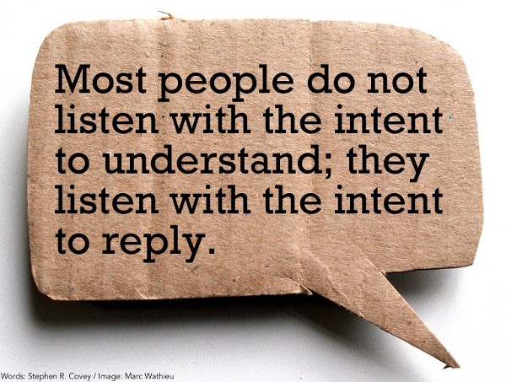

Slide 6
It’s Not About the Nail
Notes:
Video clip starts at 49 seconds

Slide 7
Discussing the Nail Video
What is the real issue represented in the video?
How many of us are good listeners?

Slide 8
What’s Your Nail?
Small Group Discussion:
What challenges do you have as managers that interfere with your ability to listen well?
Notes:
Discussion, then Group Sharing

Slide 9
Six Steps to Effective Listening
Mirror / Paraphrase
Check for understanding
Probe for information and feelings
Encourage / show empathy
Summarize
Show verbal and non-verbal attentiveness

Slide 10
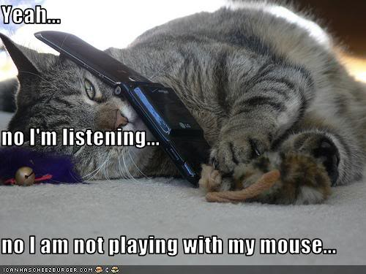
Notes:
Talk about body language and listening – how our attention to the person and body language show effective listening & respect.

Slide 11
The LARA Method
LISTEN
RESPOND
ADD INFORMATION
AFFIRM
In such a way as to understand and connect with the person speaking.
Let your instinct guide you to understand what could be happening to the speaker (underlying issues implied by their values or nonverbal cues).
To what the person is literally saying.
By attending.
Express a connection between what the speaker said and you heard.
Be genuine and truthful in your affirmation.
Paraphrase the content of the speaker’s words.
Respond in an honest, respectful and thorough manner.
Reflect the feeling and meaning of the speaker’s words.
Share additional information with the speaker.
Notes:
Where did the LARA Method come from? Look at the LARA Method summary…

Slide 12
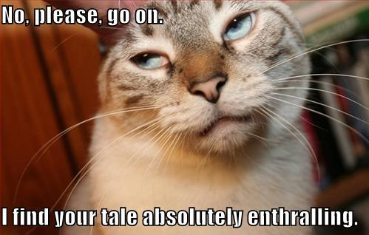
Notes:
So, do you have any questions about listening?

Slide 13
Feedback

Slide 14
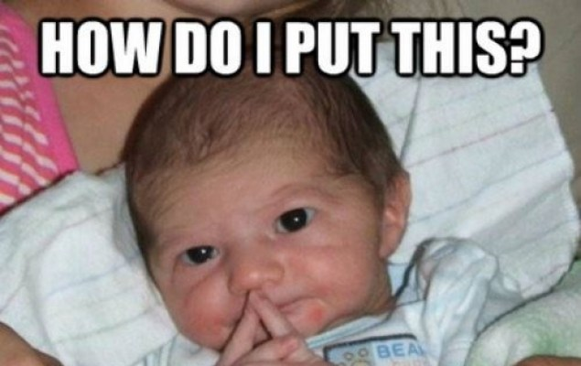

Slide 15
Giving Feedback
What is feedback?
What is the intent of feedback?
Notes:
Two reasons to give feedback:
Improve Behavior
Reinforce Behavior

Slide 16
Receiving Feedback
What is your reaction when someone tells you “I have some feedback for you”?
How do you deal with that initial angst?
Likewise, when you tell someone you would like to give them feedback, it is important to be mindful of the impact of those words.
https://www.youtube.com/watch?v=stihjalAfIk

Slide 17
Five Key Actions of Constructive Feedback
Convey your positive intent.
Describe specifically what you have observed.
State the impact of the behavior or actions.
Ask the other person to respond.
Focus the discussion on solutions (not blame).

Slide 18
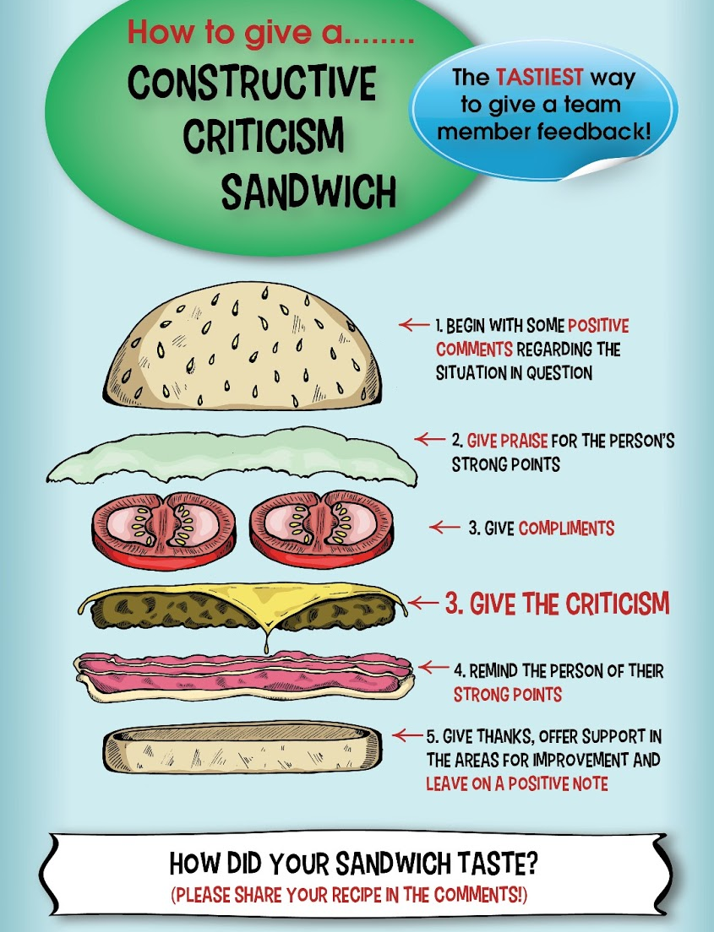
The Constructive Criticism Sandwich
Giving Feedback in a Positive Light
Copyright © 2013 Knowledge Train Limited

Slide 19
Small Group Discussion
Groups of 4 or 5 ☺
Notes:
Each group will get their own scenario and will work on their approach to Feedback.
Go back to previous slide: Five Key Actions of Constructive Feedback

Slide 20
Debrief
Did the 5 Key Actions help?
What strategies did you use?
Notes:
Did the 5 Key Actions Help? What strategies did you use?

Slide 21
The End
Thanks for joining us today… We welcome your feedback!
PS – PDs are coming! ☺ https://www.youtube.com/watch?v=_7CEmBZyGF8

